Slide 1

Clifton Corridor Transit Initiative
Project Presentation to
Lindridge-Martin Manor Neighborhood Assoc.
May 2, 2018
Notes:
Good Evening Everyone,
My name is Bryan Hobbs and I am the Project Manager overseeing the Clifton Corridor Transit Initiative for MARTA. I would like to thank Mr. Kilbride for inviting us here this evening to give you an brief update on where we stand with the project.

Slide 2
Discussion topics
Recap and Project Status
Previous Alternatives
Draft Environmental Impact Statement Alternatives
2018 Outreach
Project Next Steps
Notes:
Without further a due lets take a look at the topics we will be discussing tonight.

Slide 3
Project timeline
2009
2012
2013
2014
2015
2016
2017
2018
2009: Project Initiation - Alternatives Analysis
2012: Original LPA Adoption (‘Alternative 1’)
2013: LPA Refinement and Evaluation of Additional Options
2014: NEPA Initiation
2015: Public and Agency Scoping: Alternatives 1, 2, and 2C
2016: Evaluation of Additional Options, Selection of Alternatives 6 and 7
2017: Environmental Analysis and Documentation
2018: Complete and Publish DEIS, Enter Project Development
Notes:
So, lets discuss where this project has been and where it has come. As you know while this project has been talked about for many years, it wasn't initiated as a actual project by MARTA until 2009. During that time many different alternatives were being considered and evaluated. This took place for over a three year period, and during time each alternative was evaluated by different sets of criteria and public input.
After gathering all the input from stakeholders and evaluating impacts in 2012 an LPA was adopted by the MARTA Board.

Slide 4
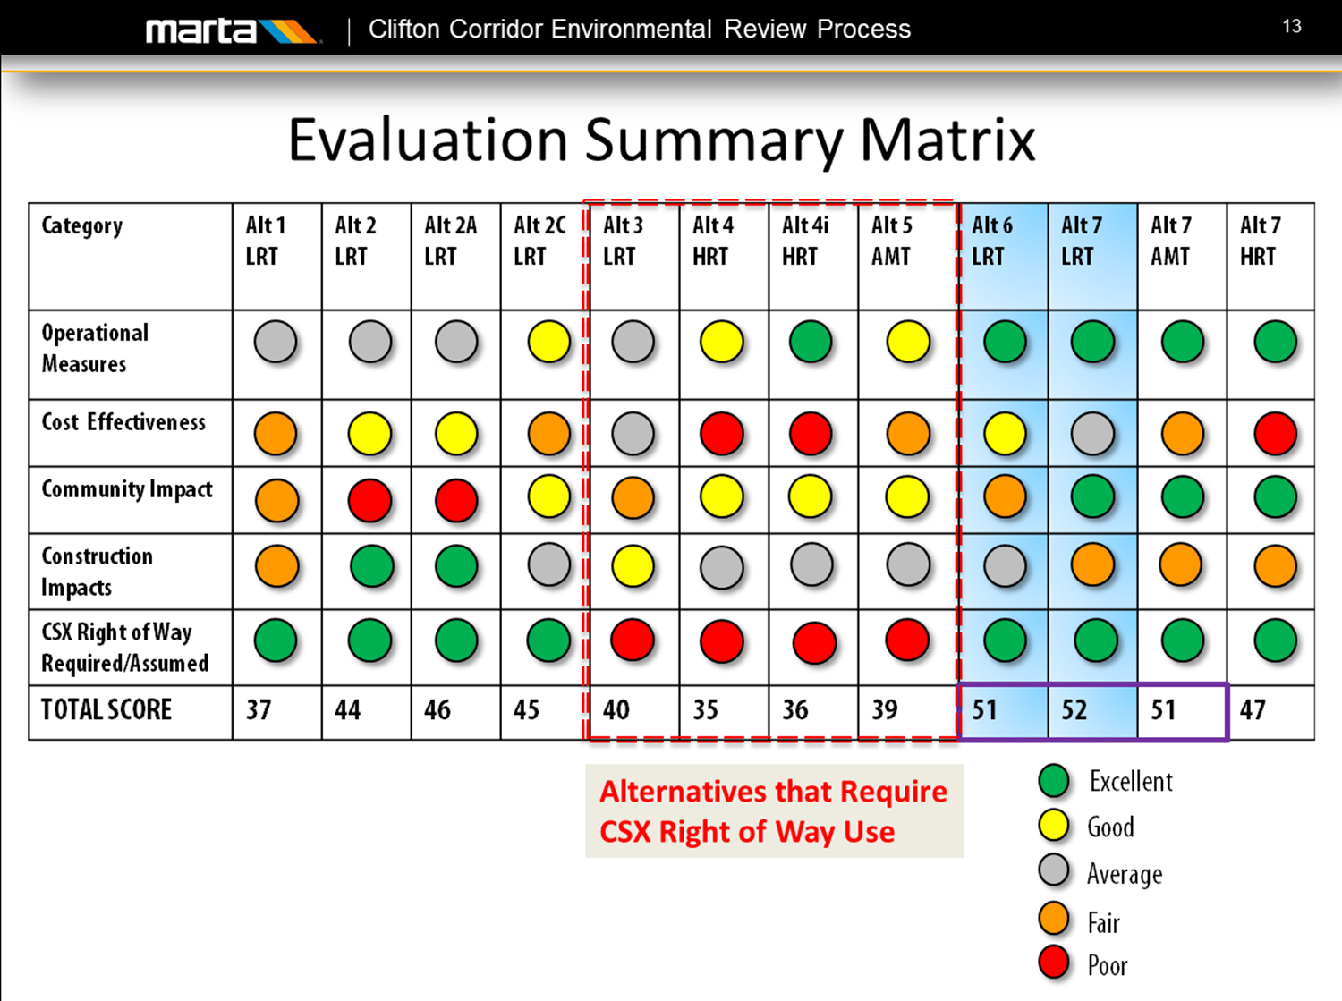
Notes:
Operation measures: travel time, travel time reliability, connectivity, accessibility
Cost effectiveness: capital costs, O&M costs, capacity utilization
Community impact: traffic impacts, property impacts, potential 4f
Construction impacts: impacts of bored tunnels/TBM staging, and impacts from cut/cover tunnels
CSX ROW assumed/required: self explanatory

Slide 5
Project status
Finalizing EIS technical reports and documentation: with publication of the DEIS expected in fall for public comment.
Renewing stakeholder and public outreach efforts to confirm preferred alignment and a first phase terminus.
Notes:
So that’s where we have been and this is where we are heading

Slide 6
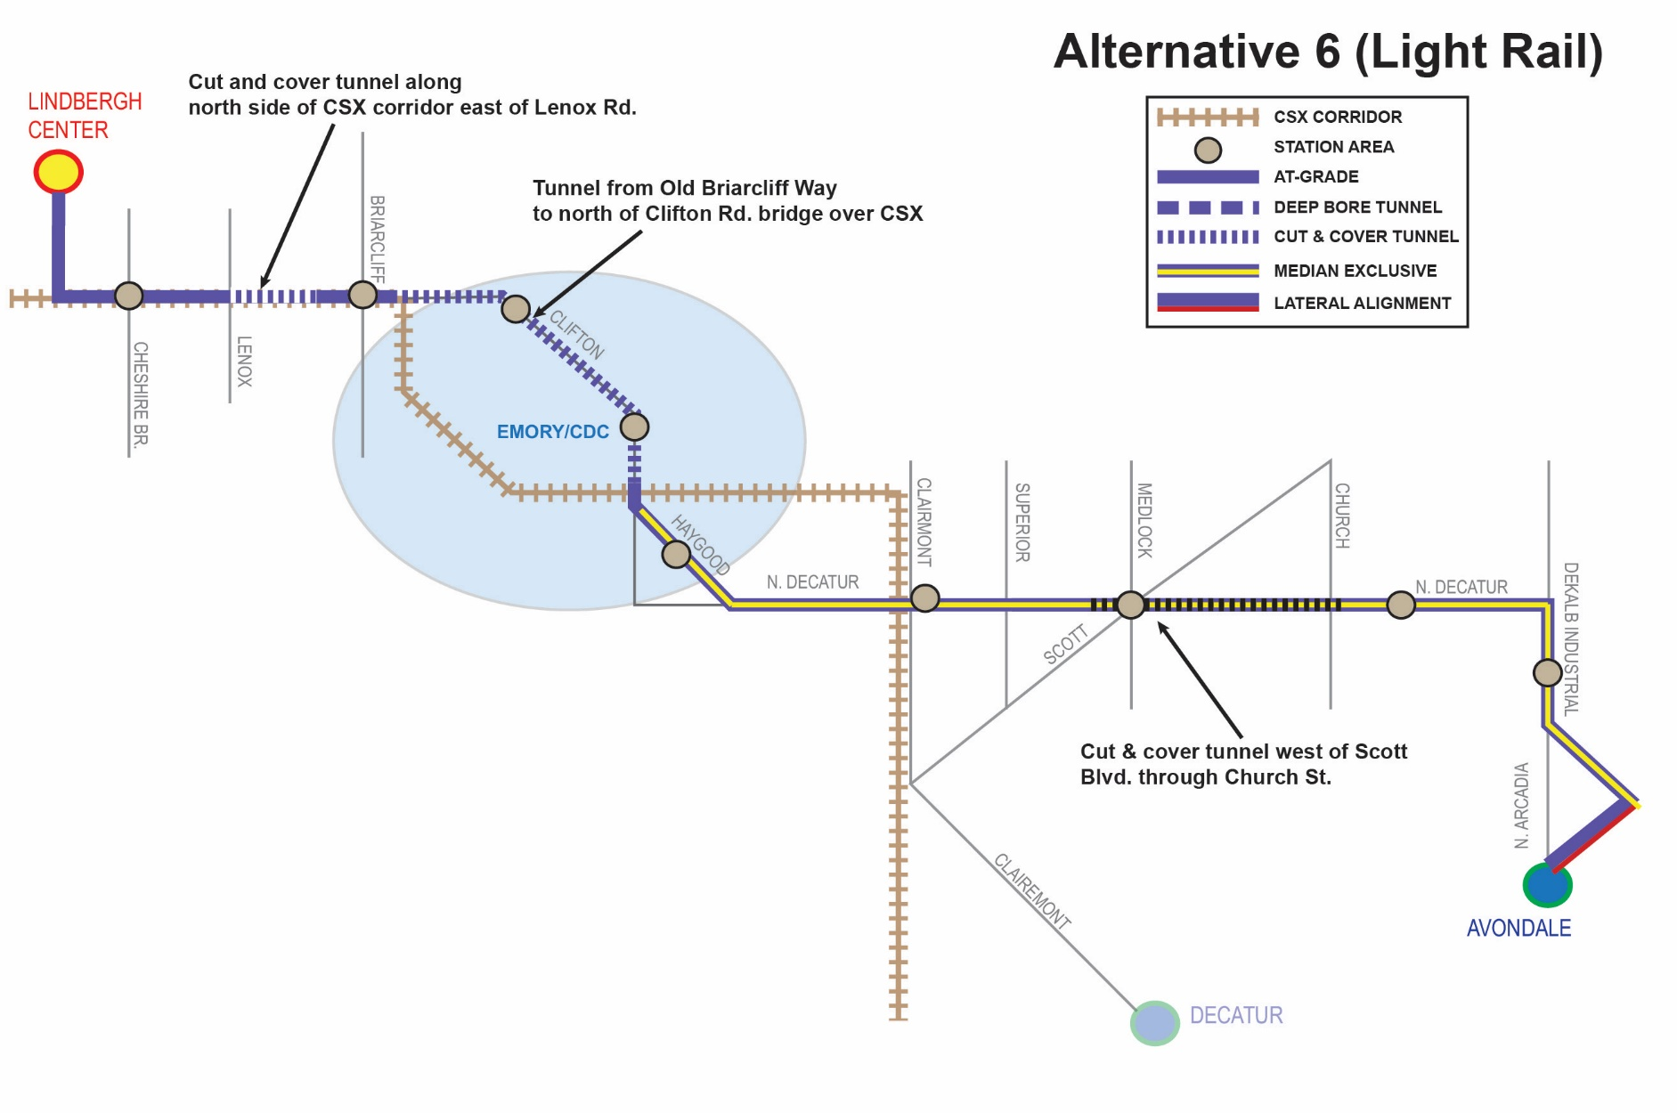
Alternative 6: At-Grade alignment, transit-only lanes
At-grade with transit-only lanes on roadway segments, and grade separated in strategic areas
Tunnels in strategic locations mitigate traffic impacts, reduce property impacts, and improve travel time reliability
LRT station integrated into Lindbergh and Avondale stations to provide easy transfers for users
End to end travel time: 26.5 minutes
Notes:
So from the past couple of slides you have heard about alternative 6 and 7. Some of you may not know what the two alignments look like so we will discuss them here.
Alternative 6 is what we are calling the at-grade alignment. The reasoning for this is that much of this alignment is above ground and operating within the median.
Cut/cover rather than bored tunnels decrease capital cost
At-grade with walk-up platforms provides convenient user access

Slide 7
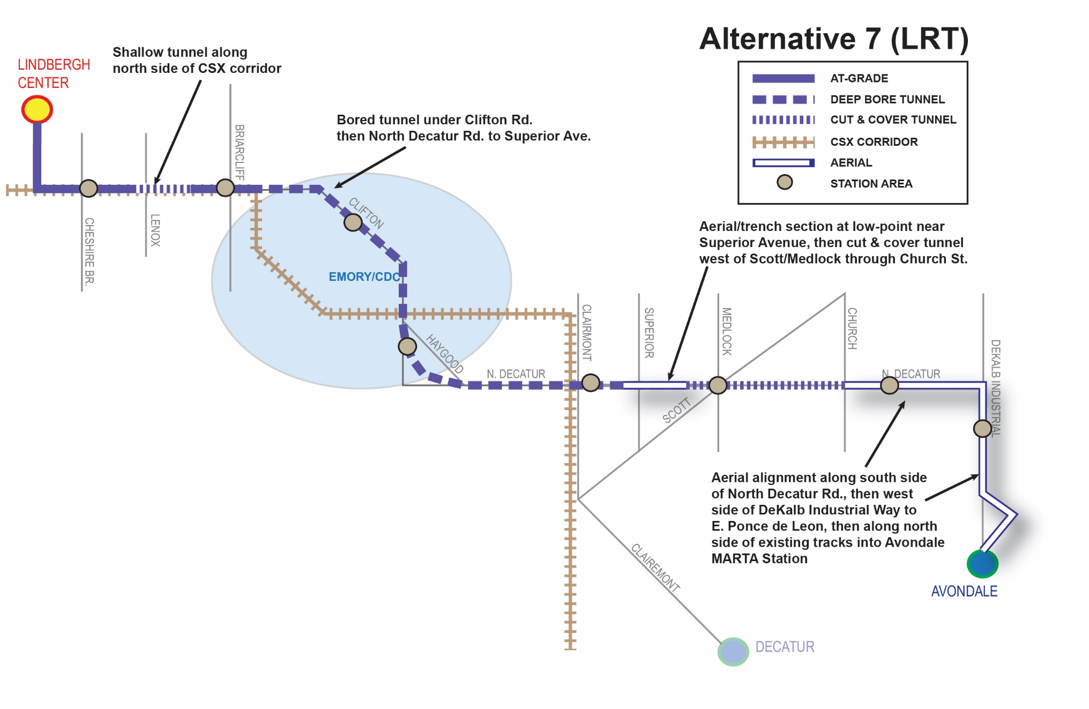
alternative 7: exclusive Guideway alignment
Entire alignment within separated guideway
Reduced property/ROW impacts
LRT station integrated into Lindbergh and Avondale stations to provide easy transfers for users
End to end travel time: 20 minutes
Notes:
Significantly higher cost due to extensive bored tunnel and aerial segment lengths
Could be designed for automated operation

Slide 8
2012 LPA vs. Current Alternatives
  Current Alternatives (Alternatives 6 and 7)
  Identical from Lindbergh Center station to Sage Hill/Briarcliff station
Lenox Road Station
  Analysis showed low ridership attributable to close proximity of Cheshire Bridge station and single-family residential density in this area
  Mix of support/opposition for station location during Public Scoping
  A station could be considered in the future if demand increases
Notes:
Primary differences in LLCC area from previous alternatives:
Lenox Road Station is not included
Cut and cover tunnel adjacent to CSX, rather than at-grade or bored tunnel. This was discussed at 2/2/2016 LLCC meeting
CSX
MARTA has communicated with CSX regarding right-of-way use – this could reduce or eliminate adjacent property impacts
Communication with CSX continues; however no agreement has been reached
A Lenox Road station is not included for Alt 6 or 7

Slide 9
Considerations for Preferred Alternative
Capital costs: Alternative 6 is substantially less expensive than Alt 7 (-82%)
    Alt 6 is $1.4 to $1.7 Billion less, depending on implementation schedule
Access: Alternative 6 provides walk-up station platforms at-grade.
    At grade stations provide travel time advantages
    Stationing for alternative 6 are much more economical
Impacts: Tunnel boring operations and staging setup areas would not be needed for Alternative 6 reducing cost and construction time.
Public/Stakeholder Support: To be determined through 2018 outreach
Recommendation: Advance Alternative 6 as the preliminary locally preferred alternative

Slide 10
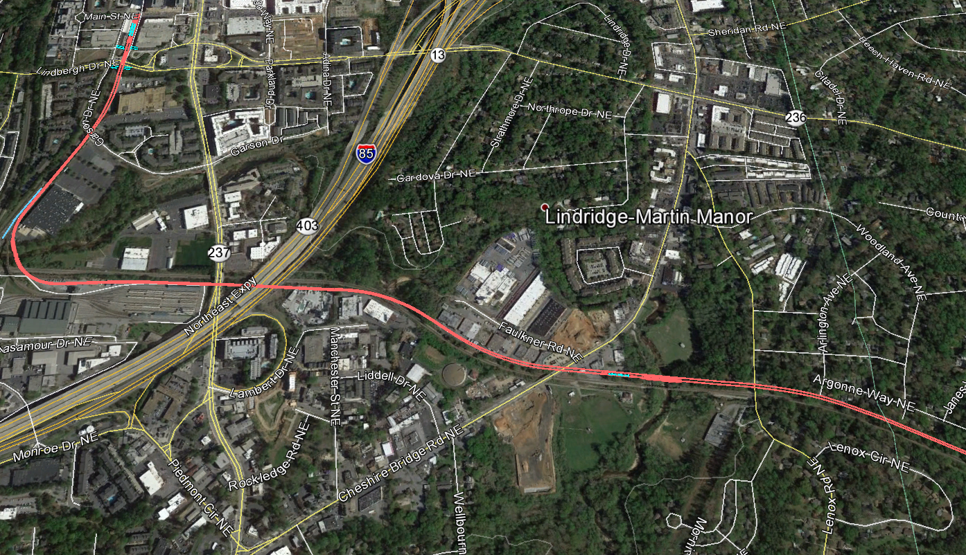
Lindridge-Martin manor
Lindbergh Center Station
Bridge from south to north side of CSX
Tunnel Section
Stream Crossing

Slide 11
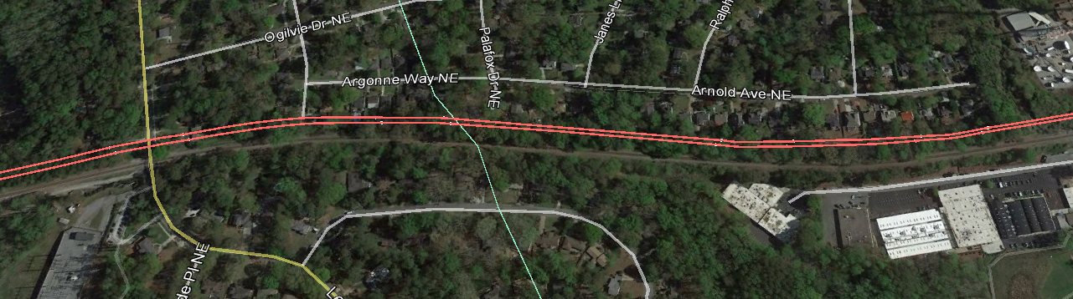
Tunnel segment
  Starts west of Lenox Road after crossing Peachtree Creek
  Goes under Lenox Road rather than crossing at-grade
  Continues through LMM and Woodland Hills area
What is Cut-and-Cover?
  The ground is excavated (cut), i.e. dug from top down, then the tunnel floor, walls, and roof are built
  Once tunnel is complete, the ground is replaced

Slide 12

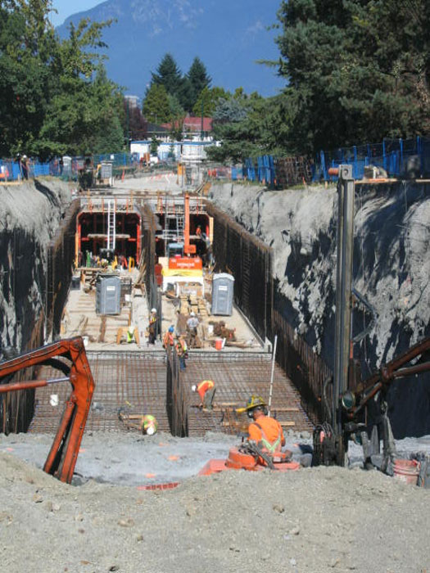
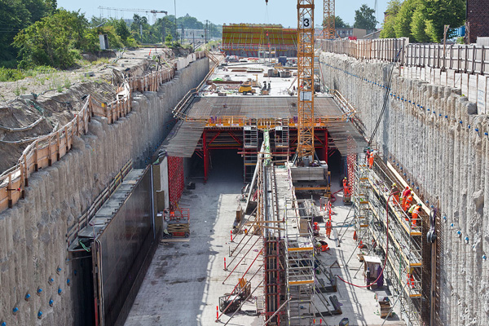

Slide 13
Project phasing
Funding
First Phase
More MARTA Atlanta sales tax could potentially fund first phase within City of Atlanta
Lindbergh Center station to North Decatur/Clairmont or Emory Area
High-capacity transit linking MARTA rail system and a major regional employment, medical and educational center
The full project extends from Lindbergh Center station to Avondale station
Other Considerations
Remaining project funding in DeKalb County has not been identified
Potential exists to construct a minimum operating segment that benefits DeKalb, City of Atlanta, MARTA, Emory, commuters and residents.
Notes:
Also possible to excavate and place a temporary cover over while tunnel construction completed
Highest impacts during construction phase, but land is replaced
Temporary impacts to backyard areas during construction: approx. 40 properties
East-west oriented lots adjacent to CSX would have higher impacts: approx. 4 acquisitions
Impact details will be confirmed with DEIS completion and preliminary engineering

Slide 14
What does the environmental impact statement (EIS) evaluate?
Transportation
Community Impacts
Natural Resources
Transit operations: potential ridership, travel times and changes to transit network
Property impacts
Water Resources: Floodplains, wetlands, stream buffers
Impacts on existing/planned transportation network – roadways, traffic, parking, transit
Natural Habitats and Species
Energy and air quality
Cultural resource impacts: historic, archaeological
Impacts to parks, recreational areas, and other community facilities
Noise and vibration impacts
Other
  Cumulative and Indirect Impacts
  Support of the Project Purpose and Need

Slide 15
Key upcoming activities
Activity | Dates/Purpose
Presentation to LLCC | Late May/ Early June. To provide information to LLCC area at-large.
New Clifton Corridor Website | Rolling out late May/ Early June. Will include new project information and announcements
Publication of Draft EIS (DEIS) | Anticipated Early Fall 2018. FTA signs the DEIS document
Public Comment Period & Public Hearing | For 45 days after publication. A public hearing required at minimum, but other public input opportunities will be offered. Comments received will be incorporated into a Final EIS (FEIS)
Community Workshop (LLCC) | After DEIS publication. To discuss local area impacts and options for mitigation.

Slide 16
Questions ?
Bryan Hobbs
Project Manager
MARTA
404-848-5733
jhobbs@itsmarta.com

